Slide 1

DATA MINING UNIT 2
Apriori Algorithm & Market Basket Analysis
Mining Frequent Itemsets and Association Rules

Slide 2
Foundational Concepts
Understanding the "What" and "Why" of Association Rules

Slide 3


WHAT IS MARKET BASKET ANALYSIS?
Definition
Business Value
A data mining technique used to uncover relationships between items. It identifies which products are frequently purchased together based on transaction history.
Allows retailers to optimize store layouts, design cross-selling marketing campaigns, and develop personalized recommendation engines.

Slide 4






THE THREE CORE METRICS
Support
Confidence
Lift
Frequency of itemsets in the dataset.
Likelihood B is bought if A is bought.
Ratio of actual support to expected support.

Slide 5
THE APRIORI PROPERTY
Downward Closure Property
Any subset of a frequent itemset must be frequent. If an itemset is infrequent, all its supersets will also be infrequent.
Prunes the search space effectively.
Minimizes database scans.
Ensures computational efficiency.

Slide 6
The Apriori Process
Step-by-Step Implementation Flow

Slide 7
SAMPLE TRANSACTION DATABASE
TID | Items Purchased
T100 | I1, I2, I5
T200 | I2, I4
T300 | I2, I3
T400 | I1, I2, I4
T500 | I1, I3
T600 | I2, I3
T700 | I1, I3
T800 | I1, I2, I3, I5
T900 | I1, I2, I3

Slide 8
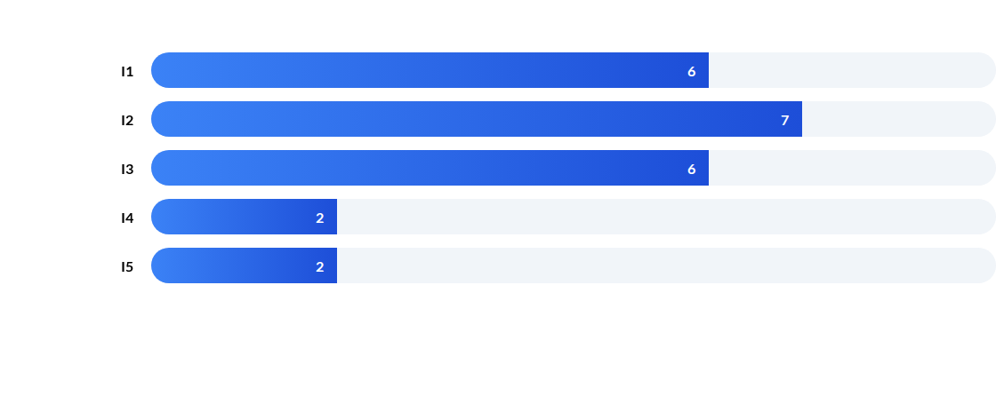
SCAN 1: ITEM FREQUENCY (L1)
Note: Assuming Minimum Support Threshold = 2. All items pass the initial scan.

Slide 9
ALGORITHMIC LIFECYCLE
Candidate Generation
Pruning
Support Counting
Termination
Self-join items to create pairs (Ck).
Remove candidates with infrequent subsets.
Scan DB to count frequency of candidates.
Repeat until no more frequent itemsets found.

Slide 10
STRONG ASSOCIATION RULES
66%
1.2
4
Confidence: {I1} → {I2}
Lift: {I1, I2}
Frequent Support Count
Results indicate that customers buying I1 have a high probability of buying I2 as well.

Slide 11
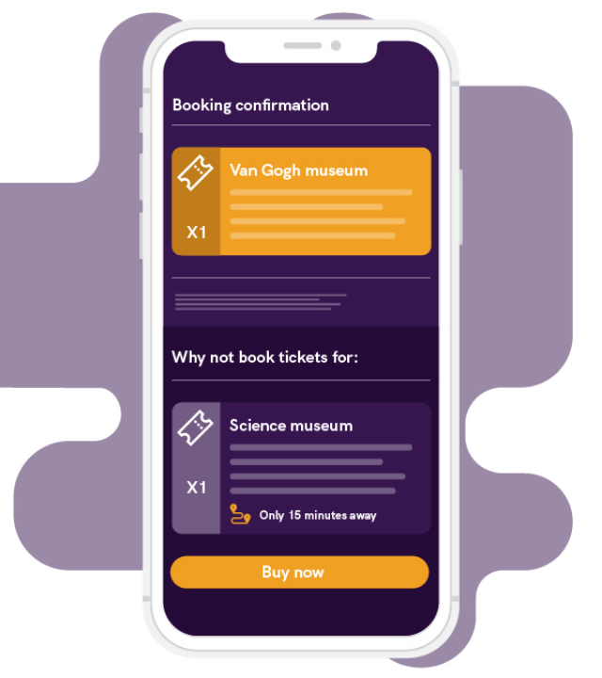
REAL WORLD APPLICATION
E-Commerce & Retail
Apriori is the backbone of recommendation engines. From Amazon's "Customers who bought this also bought" to Netflix's genre mapping, the algorithm powers personalized experiences.
Layout Optimization
Discount Bundling
Fraud Detection

Slide 12
Thank You
Data Mining: Unit 2 - Apriori Algorithm
)

